Slide 1
CONDITIONAL STATEMENTS AND LOOPS

Slide 2

The Gap by Ira Glass

Slide 3
Quantity vs. Quality?
In creative endeavors, quantity beats (and creates) quality
The pottery anecdote
Notes:
Why quantity beats (and creates) quality | Planio

Slide 4
Review: What is a Boolean?

Slide 5
Review: What are some different datatypes in Python?

Slide 6
Review: How can we get information from a user of our program?

Slide 7
Review: What function allows us to display information in our terminal?

Slide 8
Review: What is type casting, and why is it important?

Slide 9
How do our Python Scripts run…?
Currently, they run from left to right, top to bottom, just like reading a book…
But what if we wanted to only run certain sections of code if a condition was met (if the condition was True!).
  How could we do this?
Notes:
From top to bottom…
But what if we wanted to only run certain sections if a condition was met (if the condition was True!)

Slide 10
CONDITIONAL STATEMENTS
Conditions are expressions that evaluate to a Boolean value
They often involve comparison operators (<, >, ==, !=, <=, >=) and logical operators (and, or, not)
Python relies on indentation (whitespace at the beginning of a line) to define code blocks
Incorrect indentation will lead to errors.
You can create Nested Conditional Statements to control the flow of code

Slide 11
IN CLASS EXERCISE
Given:
x = 14
y = 15
Evaluate the following conditional statements
Condition | True/ False
x == 14
x > 14
y <= 15
y > x
not(x < 100)
True
False
True
True
False

Slide 12
IN CLASS EXERCISE
Given:
age = 20
money = 100
isMilitary = True
isOnPermanentProfile = False
Evaluate the following conditional statements
Condition | True/ False
age > 21 and money > 10
age > 18 and money > 0
age > 60 or isMilitary
age > 18 and isMilitary and not(isOnPermanentProfile)
False (You cannot buy an adult beverage!)
True (You can vote!)
True (You can get a discount!)
True (You’re going to war!)

Slide 13
THE "IF" STATEMENT
Executes a block of code only if a given condition evaluates to True
Syntax:
  if condition:
  # code
Example:
  age = 20
  if age >= 18:
  print(“You are eligible to vote.”)

Slide 14
THE “ELSE” STATEMENT
“Else” is used in conjunction with “if”
Provides an alternate block of code to execute if the “if” condition evaluates to false
Syntax:
  if condition:
  # code
  else condition:
  # code
Example:
  temperature = 78
  if temperature > 85:
  print(“It’s hot out today!”)
  else:
  print(“It’s not too hot.”)

Slide 15
THE “ELIF” STATEMENT
“elif” is short for else-if
It allows for checking multiple conditions sequentially
If the “if” condition evaluates to false, the “elif” statements are evaluated in order until one evaluates to True
Syntax:
  if condition:
  # code
  elif condition:
  # code
  else condition:
  # code

Slide 16
THE “ELIF” STATEMENT
Example 1:
  score = 89
  if score >= 90:
  print(“Grade: A”)
  elif score >= 80:
  print(“Grade: B”)
  elif score >= 70:
  print(“Grade: C”)
  elif score >= 60:
  print(“Grade: D”)
  else:
  print(“Grade: F”)
Example 2:
  score = 89
  if score >= 90:
  print(“Grade: A”)
  if score >= 80:
  print(“Grade: B”)
  if score >= 70:
  print(“Grade: C”)
  if score >= 60:
  print(“Grade: D”)
  else:
  print(“Grade: F”)

Slide 17
CONDITIONAL STATEMENTS (CONT.)
Conditional statements are expressions that evaluate to a Boolean value
They involve comparison operators (<, >, ==, !=, <=, >=) and logical operators (and, or, not)
Python relies on indentation (whitespace at the beginning of a line) to define code blocks
Incorrect indentation will lead to errors.
You can create Nested Conditional Statements to control the flow of code

Slide 18
NESTED CONDITIONAL STATEMENTS
You can place “if” or “if...else” statements inside other “if” or “else” blocks to create more complex decision structures.
Example:
  weather = "rainy“
  temperature = 45
  if weather == "rainy":
  if temperature < 50:
  print("It's cold and rainy. Wear a jacket and bring an umbrella.")
  else:
  print("It's rainy but warm. Just bring an umbrella.")
  else:
  print("No rain today. Enjoy the weather!")

Slide 19
EXERCISE - CONDITIONAL STATEMENTS
5 minutes
Write a script that asks a user for a number. The script then checks the number and prints “positive,” “zero,” or “negative”
Notes:
Remember:
Defining a function
If-elif-else
Comparison operators
Early exits

Slide 20
Hands-On #1
Take 30 minutes to work through Hands-On #1

Slide 21
Take a 5 minute break
Notes:
Remember:
Defining a function
If-elif-else
Comparison operators
Early exits

Slide 22
How do our Python Scripts run…?
Currently, they run from left to right, top to bottom, just like reading a book…
We also know how to make certain sections of code to run if a condition is met (if it is True!)
What if we want to run certain sections of code over and over again…
  For a defined number of iterations (definitive loop --- FOR LOOP)
  For an undefined number of iterations, until a condition is met (indefinite loop – WHILE LOOP)
Notes:
From top to bottom…
But what if we wanted to only run certain sections if a condition was met (if the condition was True!)

Slide 23
LOOPS!!!
Notes:
From top to bottom…
But what if we wanted to only run certain sections if a condition was met (if the condition was True!)

Slide 24
But first, a new datatype!
an_example_list = [1, 2, 3, “Hello”, “Goodbye”, 6.0]

Slide 25
The List [ ]
The humble list
Example:
  my_list = ['hello’]
  my_list.append('goodbye’)
  my_list.append(5)
  my_list.append(True)
  print(my_list)
  ['hello', 'goodbye', 5, True]
  print(len(my_list))
  4

Slide 26
List Indexing
  my_list = [“Python”, “is”, “oh”, “so”, “fun”]
  Index 0 1 2 3 4
  -5 -4 -3 -2 -1
  my_list[0] = ?
  my_list[4] = ?
  my_list[-1] = ?
  my_list[5] = ?
Python
fun
fun
indexError
Let’s launch the Python interpreter and verify this! Instructor Note: Demonstrate some list methods!

Slide 27
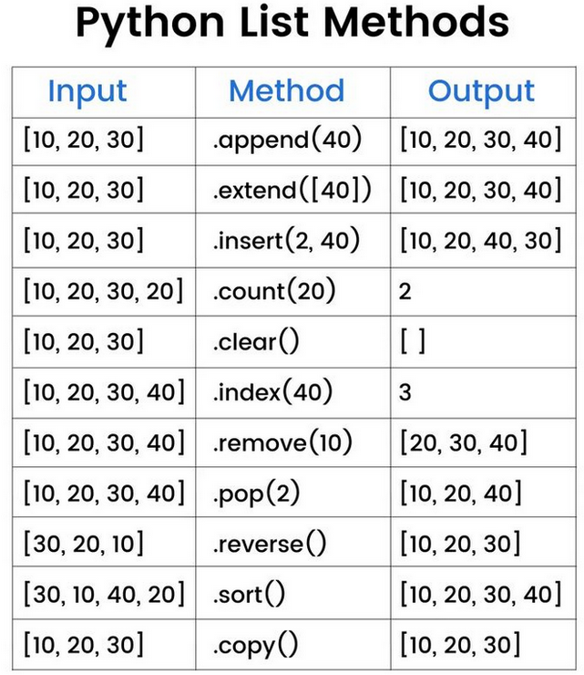
List Methods

Slide 28
RANGE() FUNCTION
A built-in Python function
Output is a “range object,” which is an immutable sequence type and memory efficient compared to a list

Slide 29
RANGE() FUNCTION
range(stop)
  Generates a sequence of numbers starting from 0 (default) up to, but not including, the stop value
  The numbers increment by 1 (default)
  Examples:
    range(5) generates 0, 1, 2, 3, 4
    range(10) generates ?
    range(3) generates ?
0, 1, 2, 3, 4, 5, 6, 7, 8, 9
0, 1, 2

Slide 30
RANGE() FUNCTION
range(start, stop)
  Generates a sequence of numbers starting from the start value (inclusive) up to, but not including, the stop value
  The numbers increment by 1 (default)
  Examples:
    range(2, 7) generates 2, 3, 4, 5, 6
    range(1, 100) generates
    range(10, 21) generates
1, 2, 3, 4 …. 97, 98, 99
10, 11, 12… 18, 19, 20

Slide 31
RANGE() FUNCTION
range(start, stop, step)
  Generates a sequence of numbers starting from the start value (inclusive) up to, but not including, the stop value
  The numbers increment or decrement by the step value (integer!)
  If step is positive, it increments. If step is negative, it decrements (for counting backwards).
  step cannot be 0, as it would lead to an infinite loop and raise a ValueError
  Example 1: range(1, 10, 2) generates 1, 3, 5, 7, 9
  Example 2: range(5, 0, -1) generates 5, 4, 3, 2, 1
  Example 3: range(1, 101, 2) generates ?
2, 4, 6, 8… 96, 98, 100 (all even numbers up to 100!)

Slide 32
LOOPS
Fundamental control flow structures used to execute a block of code repeatedly
Two primary types of loops are “for” and “while” loops, which have distinct purposes
You can nest loops

Slide 33
“FOR” LOOP
For loops iterate over a sequence, such as a list, tuple, string, or range, or other iterable objects
A block of code is executed once for each item in the sequence
Syntax:
  for loop_variable in sequence:
  # code
Example:
  fruits = ["apple", "banana", "cherry"]
  for fruit in fruits:
  print(fruit)

Slide 34
Instructor Led Examples
Use a for loop to print the numbers from 1 to 10
Create a list. Add an item to the end of the list. Use a for loop to print each item in the list.
Use a for loop to print all the even numbers between 20 and 50
Create the list [10, 20, 30, 40, 50]. Find the average value of the list using a for loop.

Slide 35
“WHILE” LOOP
While loops execute a block of statements repeatedly as long as a given condition is True
The loop continues to execute until the condition becomes false
What if we never update the variable that is being checked by our condition inside the body of our while loop?
Syntax:
  while condition:
  # block of code
Example:
  count = 0
  while count < 5:
  print(count)
  count += 1

Slide 36
Instructor Led Examples
Ask the user to input an even integer number. If the user puts in an odd number, print “This is an odd number”, and then prompt the user for an even number. Continue to do this until the user enters an even number. **Assume the user will always input an integer value**
Hard code a secret integer number between 1 and 100. Ask the user to guess the integer. If they are higher then the secret number, tell them they are higher. If they are lower, tell them they are lower. When they guess it correctly, congratulate them, and end the program.
  Bonus: Display how many times the user guessed until they got it correct after they get it correct.

Slide 37
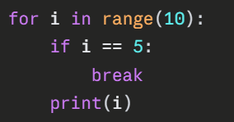
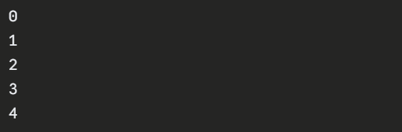
LOOP CONTROL STATEMENTS
break
  terminates the entire loop immediately, execution resumes at the statement following the loop’s body

Slide 38
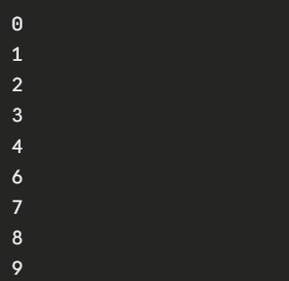
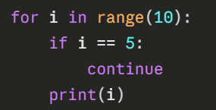
LOOP CONTROL STATEMENTS
continue
  skips the rest of the current iteration of the loop and proceeds to the next iteration of the loop

Slide 39
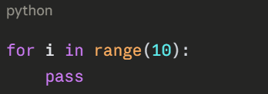
LOOP CONTROL STATEMENTS
pass
  null operation, used as a placeholder in loops or other code blocks where a statement is syntactically required but there is nothing to execute

Slide 40
NESTED LOOPS
Python allows loops inside other loops, called nested loops
The inner loop executes completely for each iteration of the outer loop
Example:
  for i in range(3):
  for j in range(2):
  print(i, j)

Slide 41
Hands-On #2
Take 30 minutes to work through Hands-On #2

Slide 42
Questions?

